Slide 1
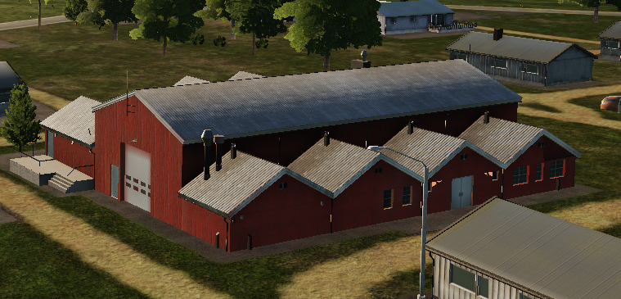
 | 500 IBS | 1000 IBS | 2000 IBS
1x Bomb
2x Bombs
4x Bombs

Slide 2
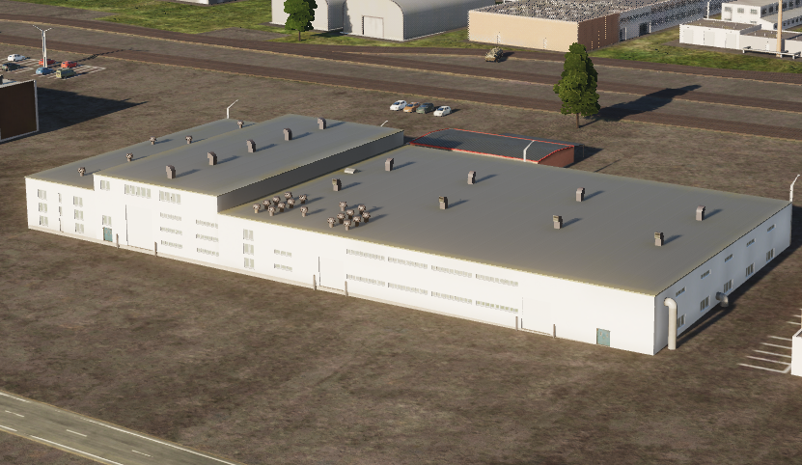
 | 500 IBS | 1000 IBS | 2000 IBS
1x Bomb
2x Bombs
4x Bombs
 | 500 IBS | 1000 IBS | 2000 IBS
1x Bomb
2x Bombs
4x Bombs

Slide 3
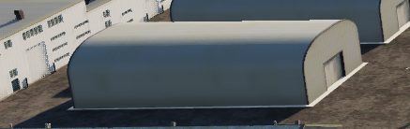
 | 500 IBS | 1000 IBS | 2000 IBS
1x Bomb
2x Bombs
4x Bombs

Slide 4
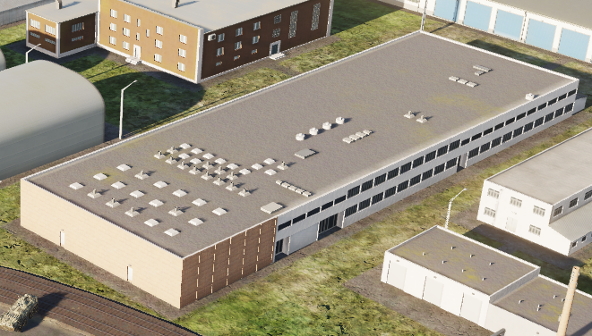
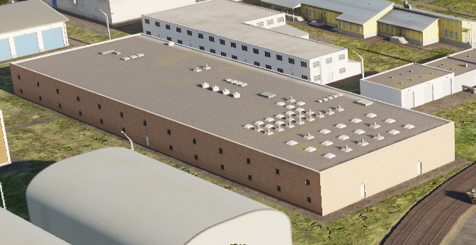
 | 500 IBS | 1000 IBS | 2000 IBS
1x Bomb
2x Bombs
4x Bombs

Slide 5
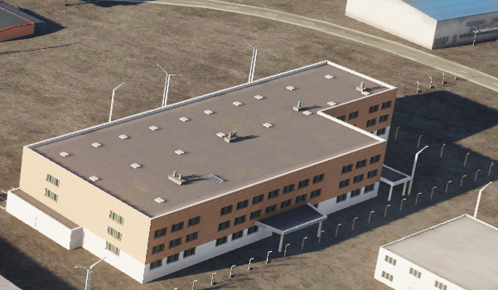
 | 500 IBS | 1000 IBS | 2000 IBS
1x Bomb
2x Bombs
4x Bombs

Slide 6
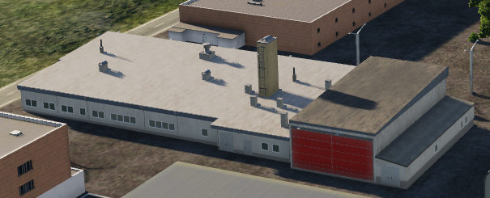
 | 500 IBS | 1000 IBS | 2000 IBS
1x Bomb
2x Bombs
4x Bombs

Slide 7
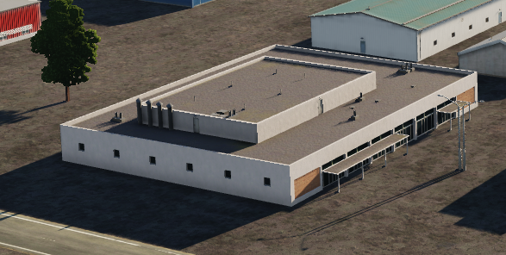
 | 500 IBS | 1000 IBS | 2000 IBS
1x Bomb
2x Bombs
4x Bombs

Slide 8
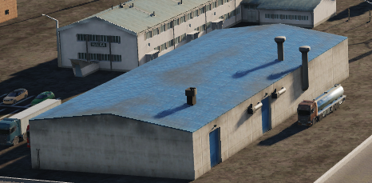
 | 500 IBS | 1000 IBS | 2000 IBS
1x Bomb
2x Bombs
4x Bombs

Slide 9
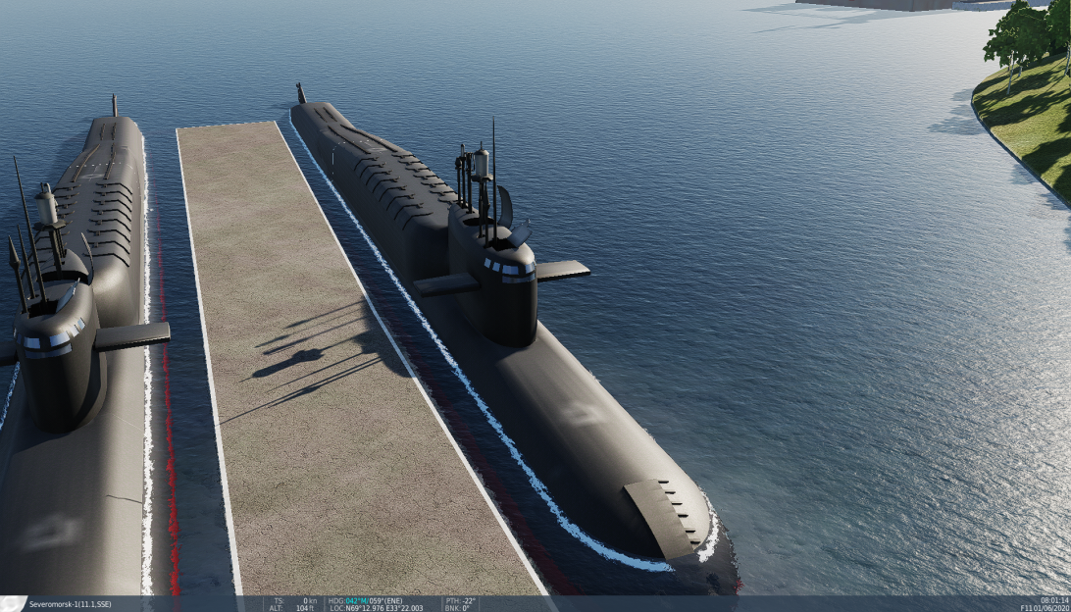
 | 500 IBS | 1000 IBS | 2000 IBS
1x Bomb
2x Bombs
4x Bombs
NOTE: Also destructable with 20mm cannon

Slide 10
VERIFIED after this

Slide 11
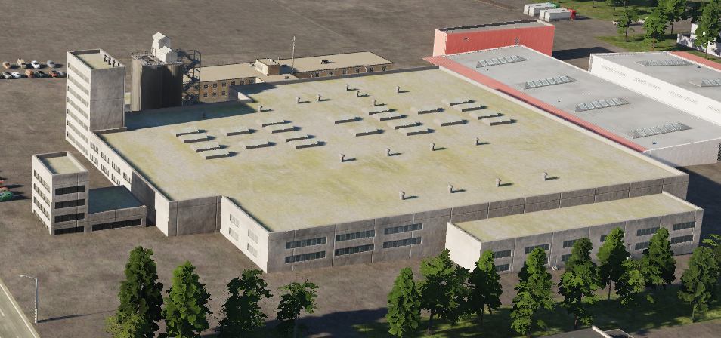
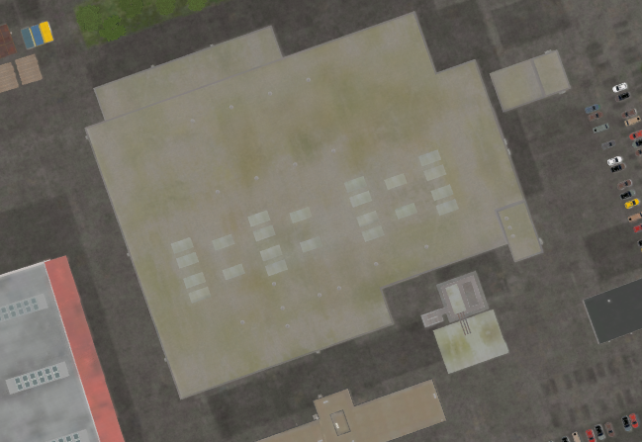
 | 500 IBS | 1000 IBS | 2000 IBS
1x Bomb
2x Bombs
4x Bombs

Slide 12
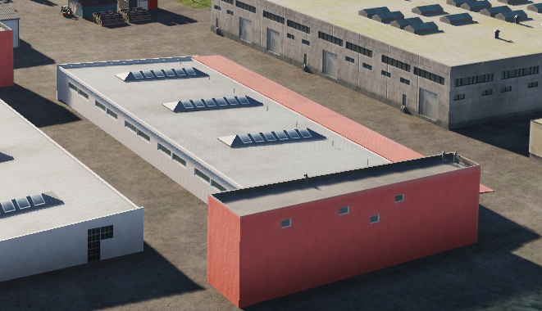
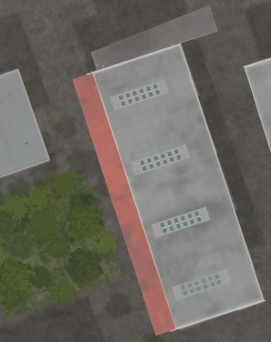
 | 500 IBS | 1000 IBS | 2000 IBS
1x Bomb
2x Bombs
4x Bombs

Slide 13
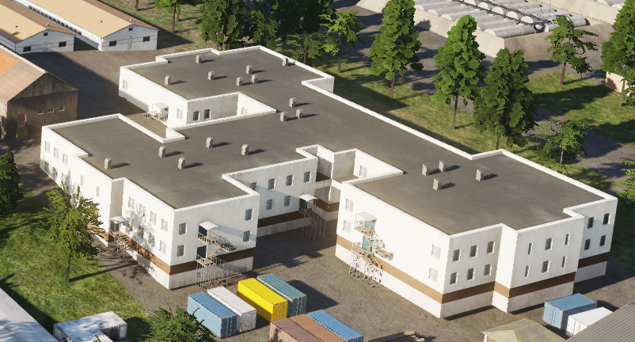
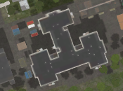
 | 500 IBS | 1000 IBS | 2000 IBS
1x Bomb
2x Bombs
4x Bombs

Slide 14
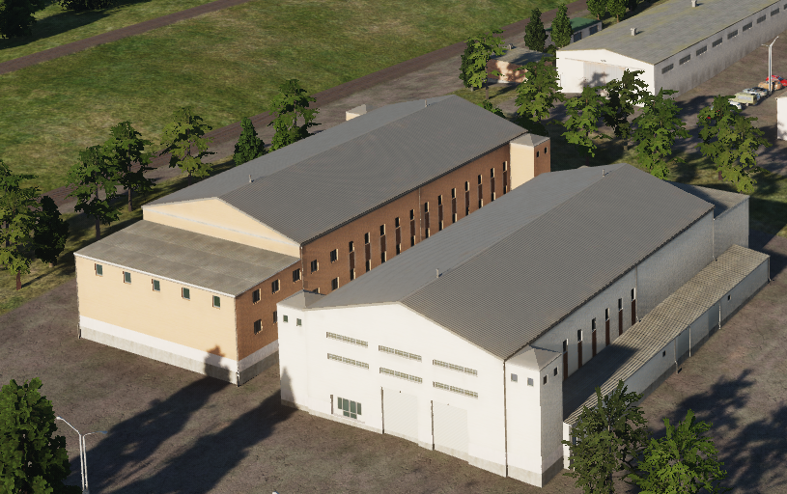
 | 500 IBS | 1000 IBS | 2000 IBS
1x Bomb
2x Bombs
4x Bombs
Same building, just different colors
Gives ruins

Slide 15
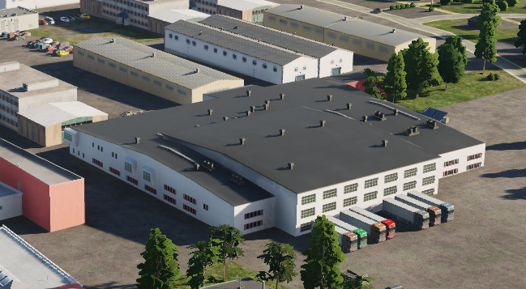
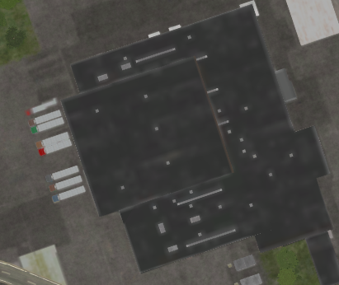
 | 500 IBS | 1000 IBS | 2000 IBS
1x Bomb
2x Bombs
4x Bombs
When destroyed, will be completely wiped from map, and gives not ruins

Slide 16
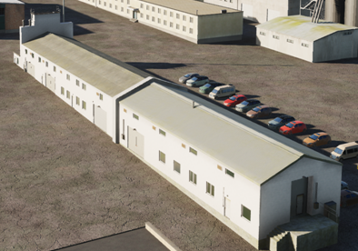
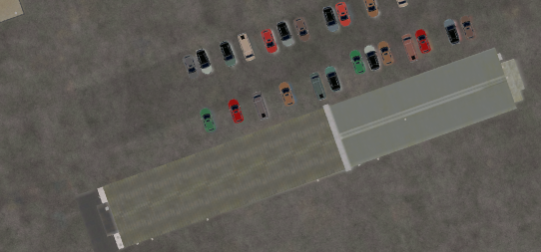
 | 500 IBS | 1000 IBS | 2000 IBS
1x Bomb
2x Bombs
4x Bombs
Gives ruins

Slide 17
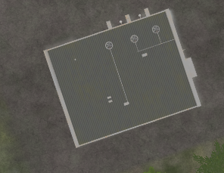
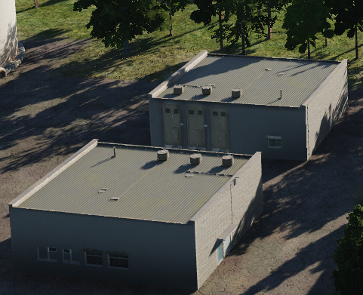
 | 500 IBS | 1000 IBS | 2000 IBS
1x Bomb
2x Bombs
4x Bombs
Gives ruins

Slide 18
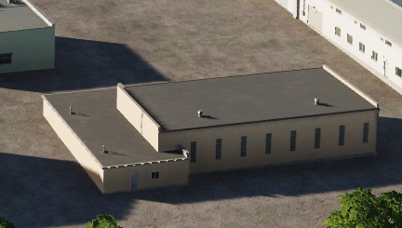
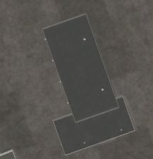
 | 500 IBS | 1000 IBS | 2000 IBS
1x Bomb
2x Bombs
4x Bombs

Slide 19
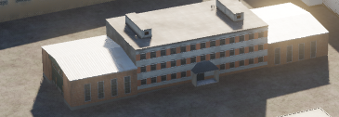
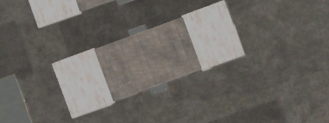
 | 500 IBS | 1000 IBS | 2000 IBS
1x Bomb
2x Bombs
4x Bombs
Gives ruins

Slide 20
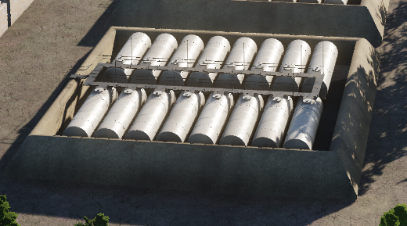
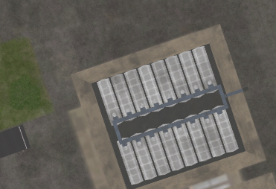
 | 500 IBS | 1000 IBS | 2000 IBS
1x Bomb
2x Bombs
4x Bombs
Gives ruins

Slide 21
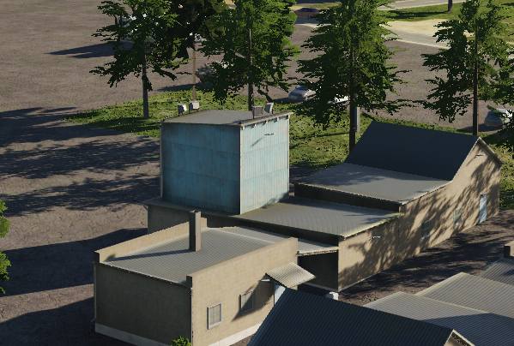
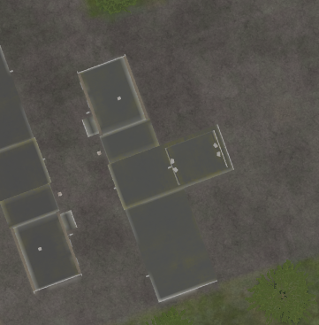
 | 500 IBS | 1000 IBS | 2000 IBS
1x Bomb
2x Bombs
4x Bombs
Gives ruins

Slide 22
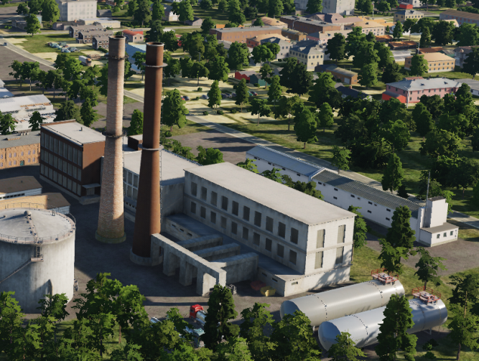
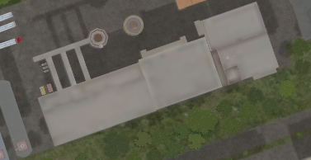
 | 500 IBS | 1000 IBS | 2000 IBS
1x Bomb
2x Bombs
4x Bombs
When destroyed, will be completely wiped from map, and gives not ruins

Slide 23
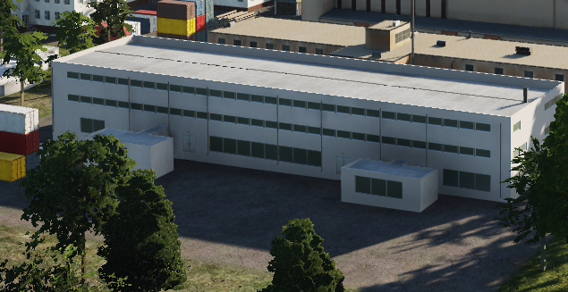
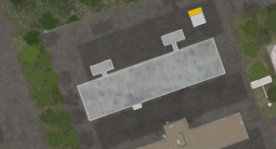
 | 500 IBS | 1000 IBS | 2000 IBS
1x Bomb
2x Bombs
4x Bombs
When destroyed, will be completely wiped from map, and gives not ruins

Slide 24
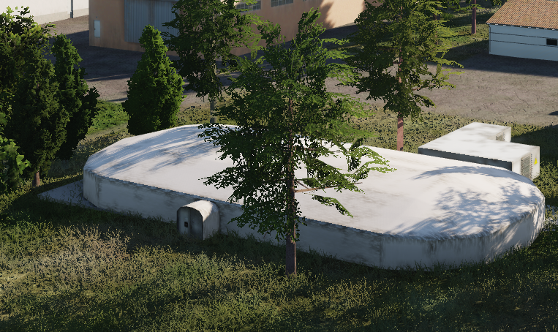
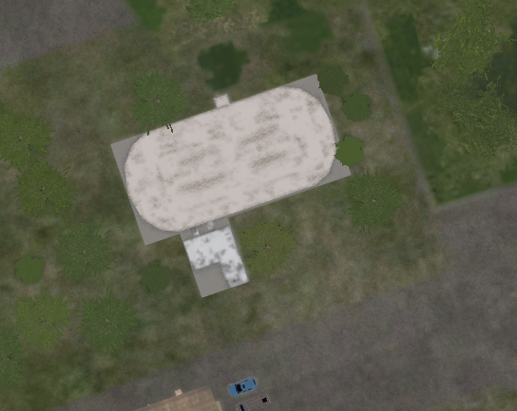
 | 500 IBS | 1000 IBS | 2000 IBS
1x Bomb
2x Bombs
4x Bombs
When destroyed, will be completely wiped from map, and gives not ruins

Slide 25
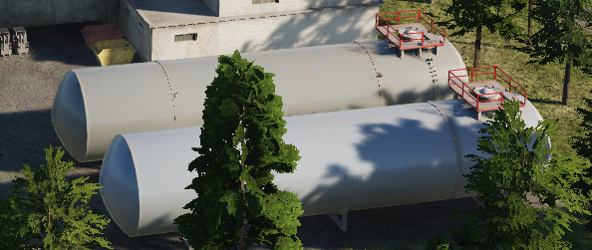
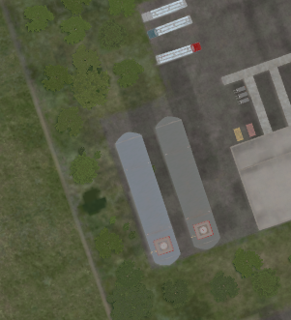
 | 500 IBS | 1000 IBS | 2000 IBS
1x Bomb
2x Bombs
4x Bombs
Gives ruins

Slide 26
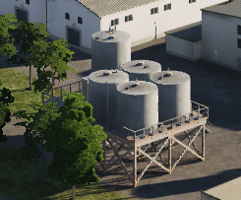
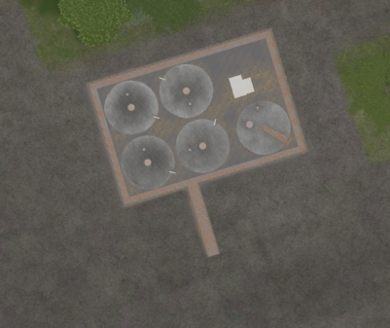
 | 500 IBS | 1000 IBS | 2000 IBS
1x Bomb
2x Bombs
4x Bombs
Gives ruins

Slide 27
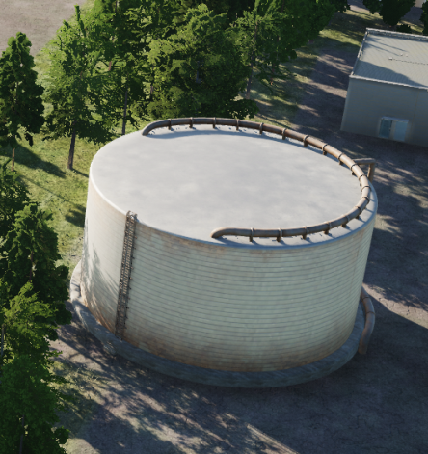
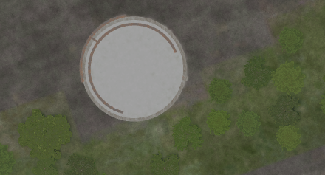
 | 500 IBS | 1000 IBS | 2000 IBS
1x Bomb
2x Bombs
4x Bombs
When destroyed, will be completely wiped from map, and do not give ruins

Slide 28
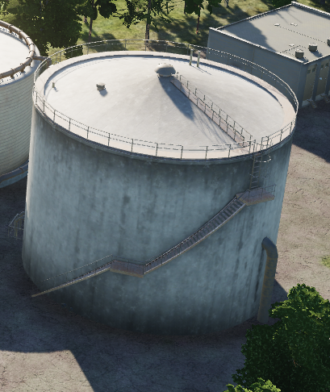
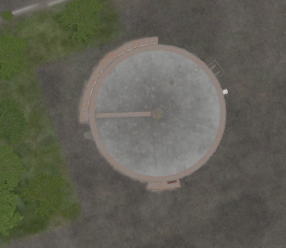
 | 500 IBS | 1000 IBS | 2000 IBS
1x Bomb
2x Bombs
4x Bombs
Gives ruins

Slide 29
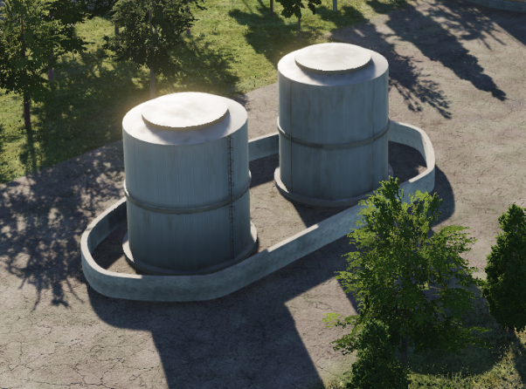
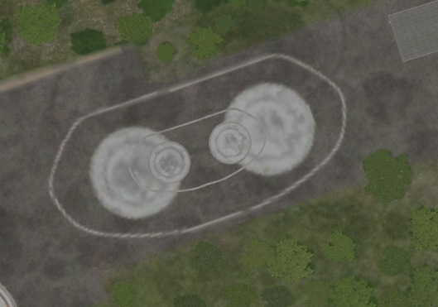
 | 500 IBS | 1000 IBS | 2000 IBS
1x Bomb
2x Bombs
4x Bombs

Slide 30
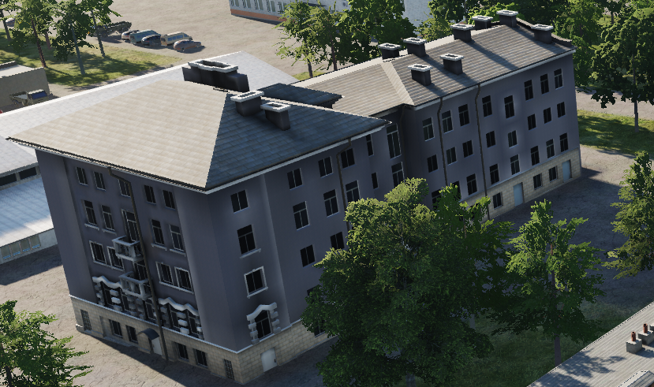
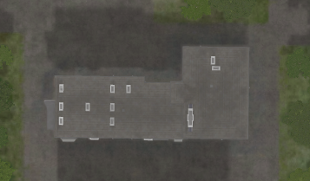
 | 500 IBS | 1000 IBS | 2000 IBS
1x Bomb
2x Bombs
4x Bombs
When destroyed, will be completely wiped from map, and gives not ruins

Slide 31
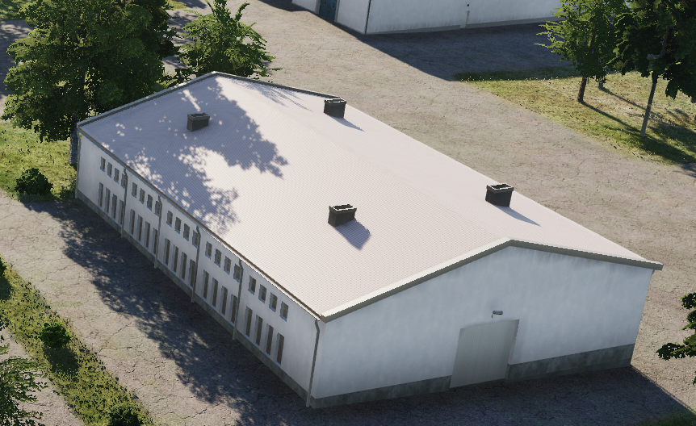

 | 500 IBS | 1000 IBS | 2000 IBS
1x Bomb
2x Bombs
4x Bombs
Gives ruins

Slide 32




 | 500 IBS | 1000 IBS | 2000 IBS
1x Bomb
2x Bombs
4x Bombs
When destroyed, will be completely wiped from map, and gives not ruins.
But will give ”fireworks” /secondary explosions

Slide 33


 | 500 IBS | 1000 IBS | 2000 IBS
1x Bomb
2x Bombs
4x Bombs
When destroyed, will be completely wiped from map, and gives not ruins

Slide 34


 | 500 IBS | 1000 IBS | 2000 IBS
1x Bomb
2x Bombs
4x Bombs
When destroyed, will be completely wiped from map, and do not give ruins

Slide 35


 | 500 IBS | 1000 IBS | 2000 IBS
1x Bomb
2x Bombs
4x Bombs
When destroyed, will be completely wiped from map, and gives not ruins.
But will give ”fireworks” /secondary explosions

Slide 36


 | 500 IBS | 1000 IBS | 2000 IBS
1x Bomb
2x Bombs
4x Bombs
INDESTRUCTABLE

Slide 37


 | 500 IBS | 1000 IBS | 2000 IBS
1x Bomb
2x Bombs
4x Bombs
INDESTRUCTABLE

Slide 38


 | 500 IBS | 1000 IBS | 2000 IBS
1x Bomb
2x Bombs
4x Bombs
INDESTRUCTABLE

Slide 39


 | 500 IBS | 1000 IBS | 2000 IBS
1x Bomb
2x Bombs
4x Bombs
INDESTRUCTABLE

Slide 40


 | 500 IBS | 1000 IBS | 2000 IBS
1x Bomb
2x Bombs
4x Bombs
INDESTRUCTABLE

Slide 41


 | 500 IBS | 1000 IBS | 2000 IBS
1x Bomb
2x Bombs
4x Bombs
INDESTRUCTABLE

Slide 42


 | 500 IBS | 1000 IBS | 2000 IBS
1x Bomb
2x Bombs
4x Bombs
INDESTRUCTABLE

Slide 43


 | 500 IBS | 1000 IBS | 2000 IBS
1x Bomb | x
2x Bombs | x
4x Bombs | x
INDESTRUCTABLE

Slide 44
UNDER TESTING AFTER THIS

Slide 45
 | 500 IBS | 1000 IBS | 2000 IBS
1x Bomb
2x Bombs
4x Bombs

